Slide 1
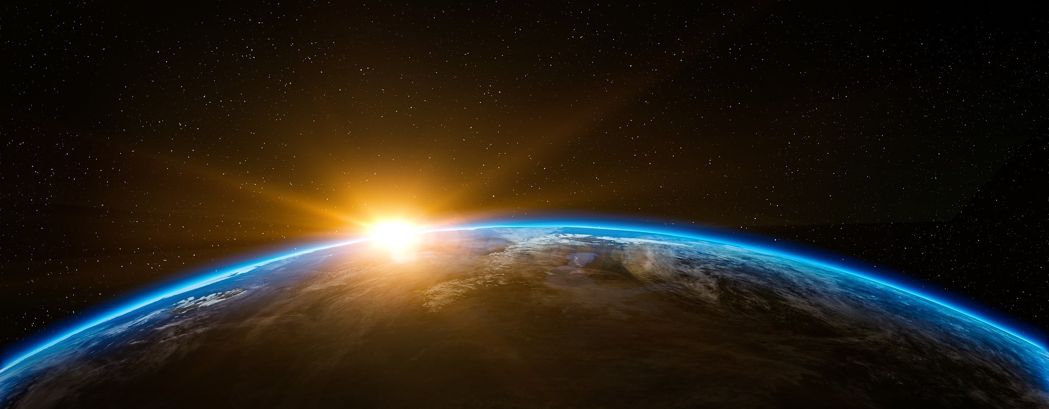
Global GEP Paper
January 13, 2025

Slide 2


Slide 3
NatCap TEEMs
Our mission: integrate ecological and economic data in Earth-Economy models to inform decision-making for sustainable development
Notes:
Pressing need for this work. Sound foundation and strong partnerships. But time is pressing. Move faster – scale up. Hope to work with many of you in the room and on-line to do this work and be better stewards of the biosphere and meet the goals of sustainable development.

Slide 4
Goal of earth economy modeling
Reconstructing the economic and financial system to recognize the value of nature
Have public and private sector fully reflect the value of nature in decision-making
Align economic activity with long-term sustainable development

Slide 5
Outline of GEP paper
Title: An Initial Calculation of Gross Ecosystem Product by Country
Introduction
The need for GEP
GEP defined
Brief overview of data and methods to calculate GEP
Results
Results by country
Results by ecosystem service

Slide 6
Outline of the paper
Discussion
Summary of important findings
Relationship of GEP to SEEA CF and EA (and other efforts)
Applications of GEP to policy and decision-making
Important limitations/challenges
Concluding thoughts
Materials and methods
General approach to calculation of ecosystem service values
Supplementary information
Detailed description of data and methods for how we calculate value for each service

Slide 7
The need for GEP

Slide 8
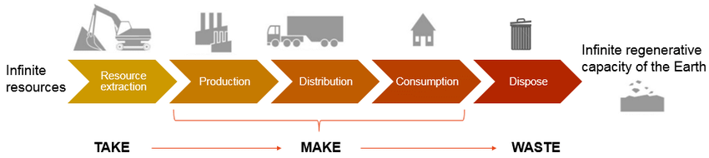
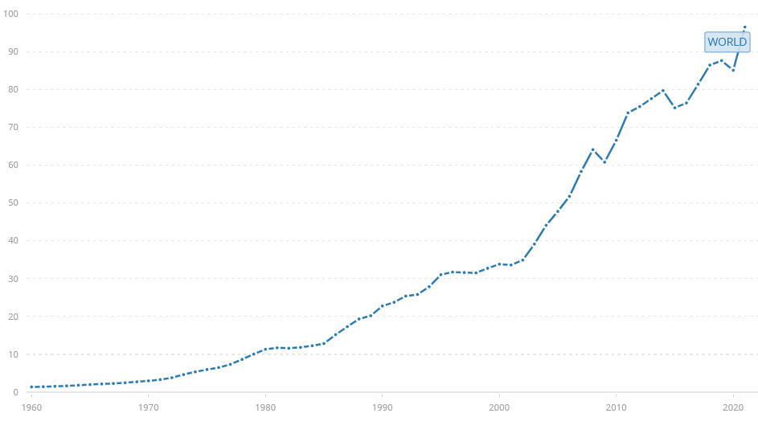
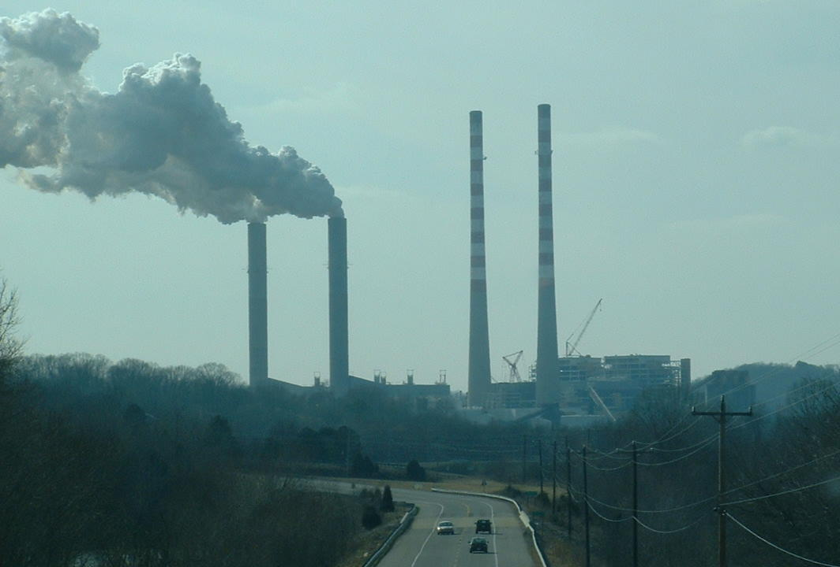
Holocene institutions & Holocene economy
Global GDP 1960-2020 (World Bank)
https://data.worldbank.org/indicator/NY.GDP.MKTP.CD

Slide 9
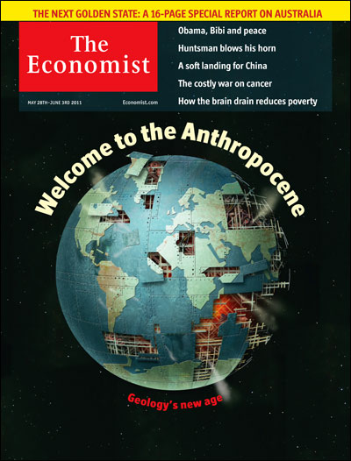
Anthropocene reality: new institutions and economics needed
Rockström et al. 2009

Slide 10
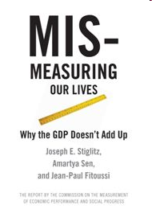
Moving beyond GDP
GDP provides clear and easily understood signal of narrow economic performance
Widespread recognition of the need to move beyond GDP for more complete performance measures of the ecological, economic, and social systems supporting human wellbeing

Slide 11
Need for Gross Ecosystem Product (GEP)
Currently lack a measure that provides a clear signal of ecological performance and the contribution of nature to human well-being
Brauman et al. PNAS 2020

Slide 12
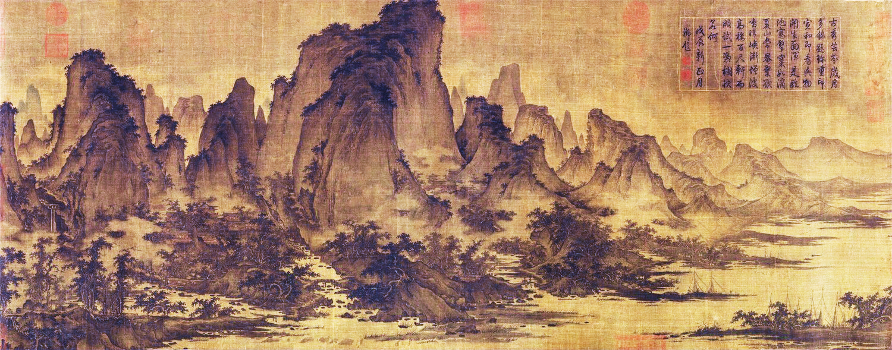
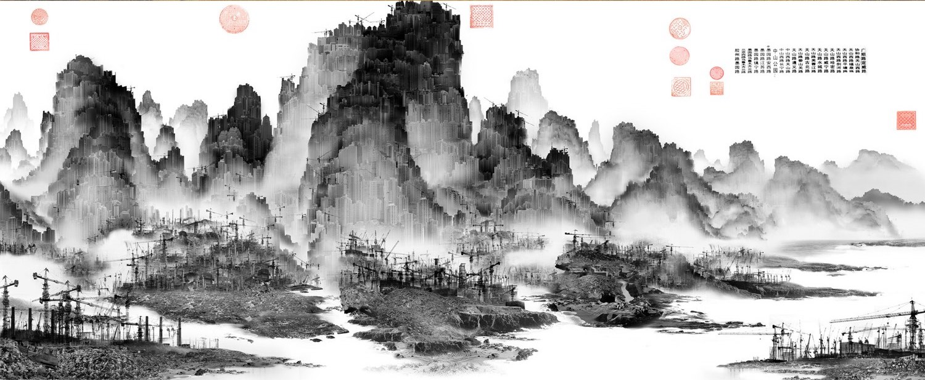
“Summer Mountains” by
QU Ding 屈鼎 (12th Century)
“Phantom Landscape” by
YANG Yongliang 杨泳梁 (2006)

Slide 13
GEP defined

Slide 14
GEP and GDP
GDP: summary statistic that measures the flow of income from marketed goods and services
GEP: summary statistic that measures the flow of value from ecosystem goods and services. GEP is a measure of the aggregate monetary value of ecosystem-related goods and services in a given region in an accounting period
GDP
GEP
Marketed
ecosystem services
Marketed
non-ecosystem
goods and services
Non-marketed
ecosystem services

Slide 15
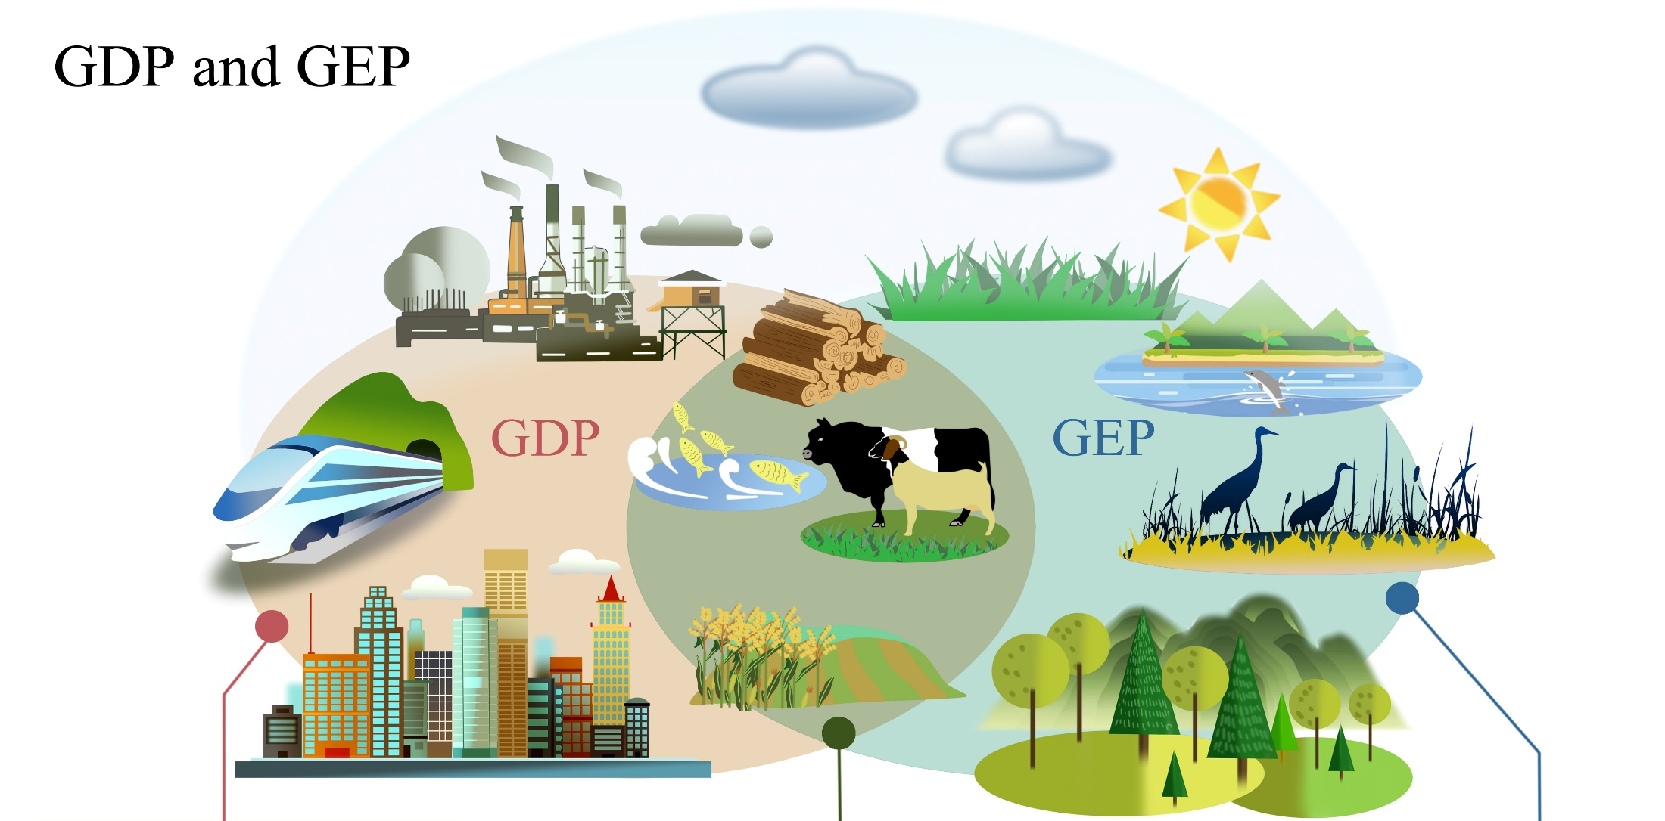
GDP and GEP
Flood Protection
Air & Water Purification
Crop Pollination
(Mental Health)
Manufacturing
Construction
Transportation
Communication
Agriculture
Forestry
Tourism
(Ouyang et al. 2020 PNAS)

Slide 16
Overview of methods

Slide 17

Measuring GEP’s
Value of an ecosystem service: Price * Quantity
From a complete list of ecosystem services, use the subset that have information about both price and quantity from globally available data

Slide 18
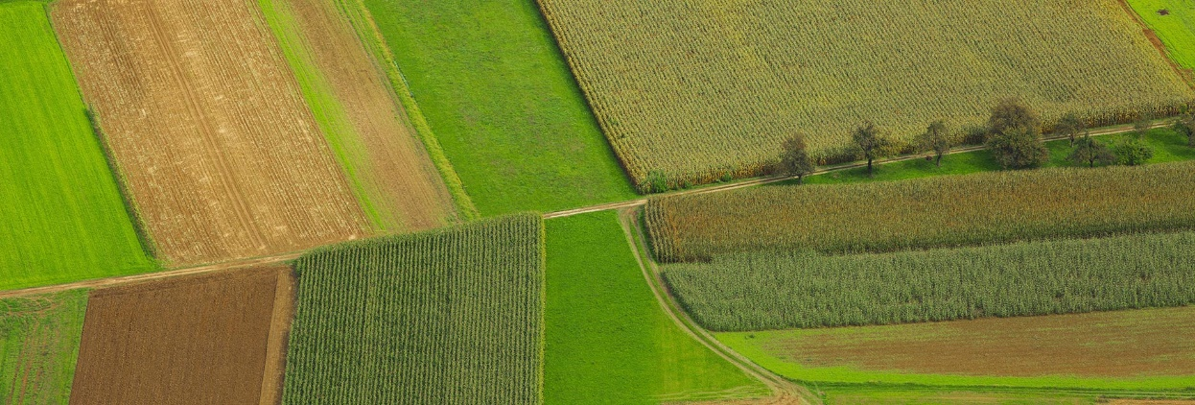

Measuring GEP: “Easier” to measure ecosystem services
Ecosystem services with relevant globally available price and quantity data (some material services)
Crops
Commercial fisheries…
For GEP, we need the portion of value that is attributable to nature
Example: agricultural crops
Subtract the value of human labor and manufactured inputs to get the contribution of nature
Photo credits: Croplands Research Group (top)
National Geographic (bottom)

Slide 19
Measuring GEP: Harder to measure ecosystem services
Services without relevant globally available price and quantity data (virtually all regulatory services, non-material services)
Steps to create GEP
Tracking the magnitude and condition of biophysical stocks of natural capital (lands, waters, and their biodiversity)
Translating these stocks into flows of ecosystem goods and services
Pricing (valuing) ecosystem goods and service flows

Slide 20
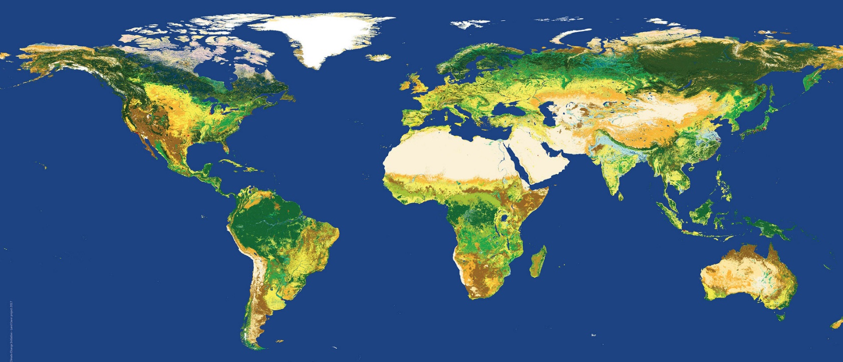
1. Tracking the magnitude and condition of biophysical stocks of natural capital
Stocks of natural capital are an important measure in their own right (Natural Capital Accounting)
Stocks of natural capital generate a flow of ecosystem goods and services

Slide 21
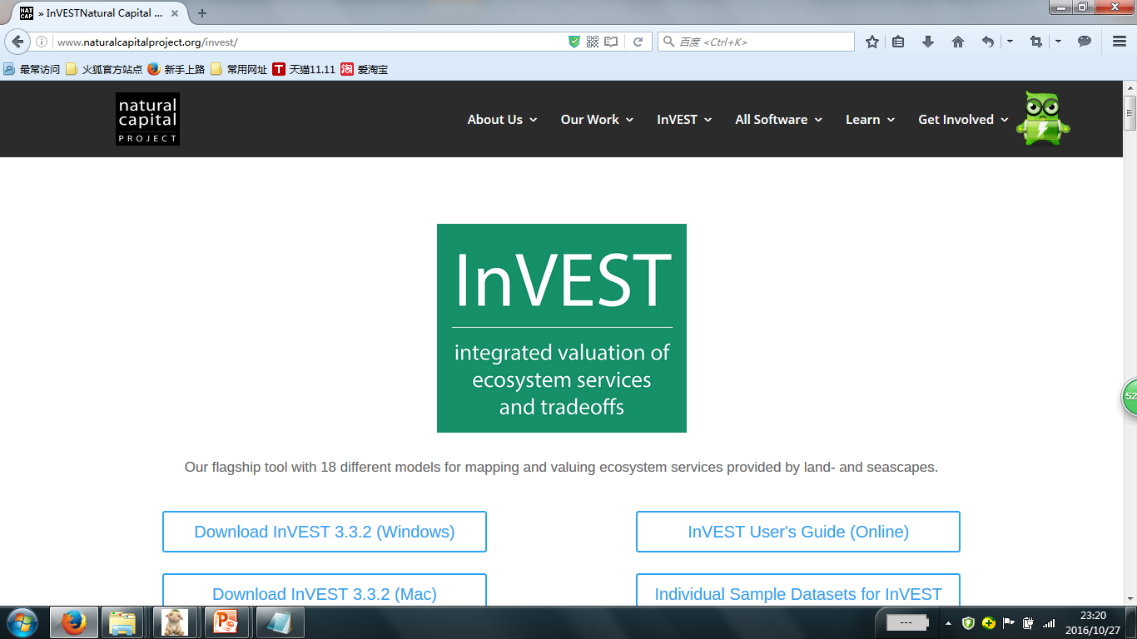
2. Translating natural capital stocks into flows of ecosystem goods and services
Water retention Flood mitigation
by forests by wetlands
Biodiversity conservation
(Ouyang et al 2016 Science)

Slide 22
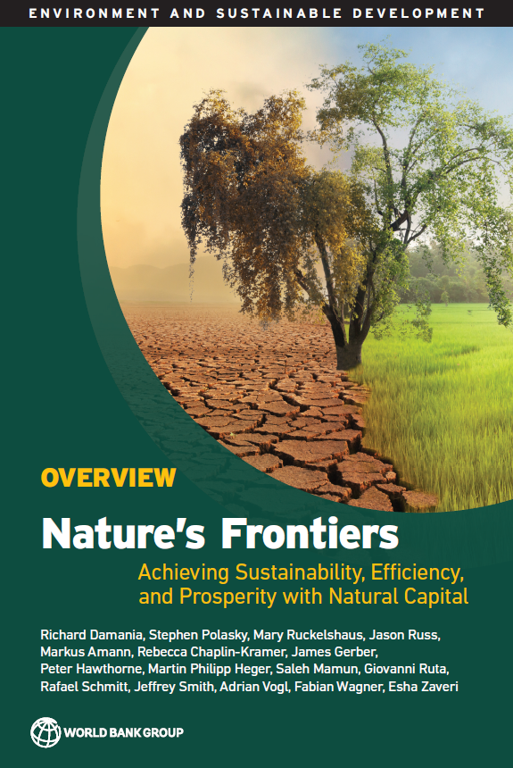
Global coverage of ecosystem services
Science 2019

Slide 23
3. Pricing (valuing) ecosystem goods and service flows
Many ecosystem goods and services do not have a readily observable market price
GEP addresses this omission by estimating price analogues for non-market ecosystem goods and services
Common methods of “pricing” non-marketed ecosystem services
Imputed values for inputs to marketed goods and services
Avoided cost
Replacement cost
Note: many common approaches to non-market valuation from environmental economics, based on willingness-to-pay measures, are rarely used: hedonic property price approach, random utility models (travel cost), choice experiments (contingent valuation)

Slide 24
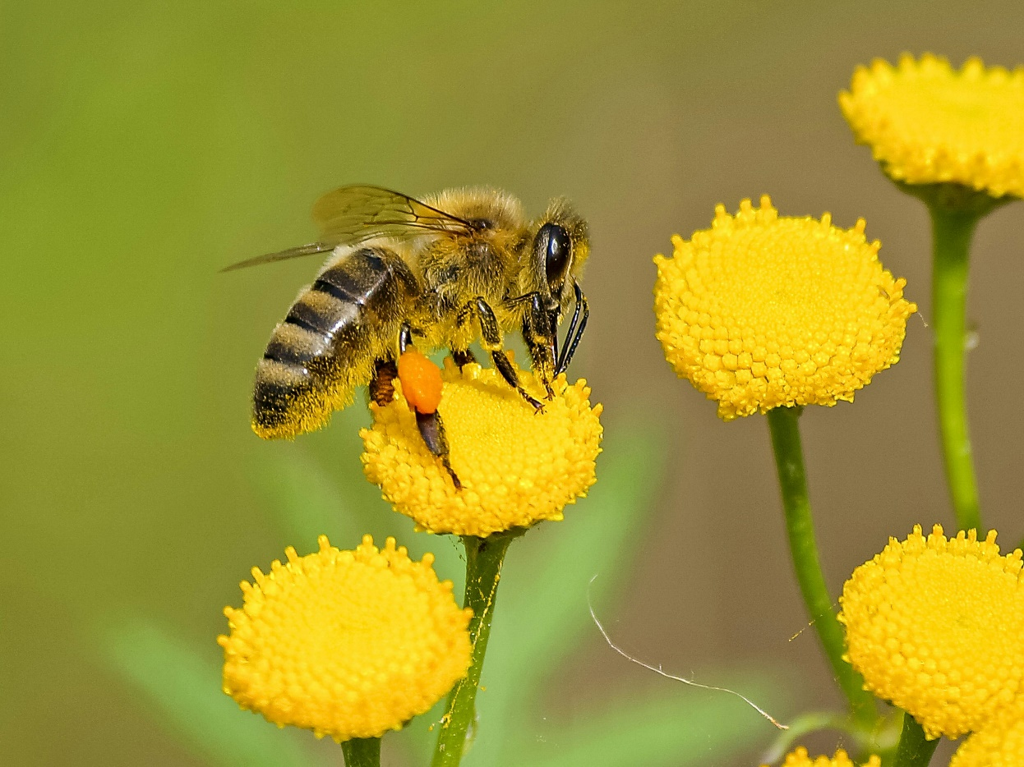
Aggregating services for GEP
Aggregate the values of ecosystem goods and services into a single GEP metric
Want complete coverage of all important ecosystem goods and services
Avoid double-counting
Photo credit: Pixabay

Slide 25
Results

Slide 26
To be done….

Slide 27
Example: GEP Accounting in Qinghai (2000 – 2015)
Types of services | Category of ecosystem services | Ecosystem service | 2000 |  |  | 2015
 |  |  | Bio-physical quantity | Monetary value (Billion Yuan) | % of total value | Bio-physical quantity | Monetary value (Billion Yuan) | % of total value
Material services | Production of ecosystem goods | Agricultural crop production (x10³t) | 1652.1 | 1.0 | 1.2 | 3091.2 | 5.6 | 3.0
 |  | Animal husbandry production (x10³t) | 458.7 | 1.1 | 1.4 | 724 | 5.8 | 3.1
 |  | Fishery production (x10³t) | 1.2 | 0.01 | 0.01 | 10.6 | 0.3 | 0.1
 |  | Forestry production (x10³m³) | 1800 | 0.2 | 0.2 | 825 | 0.7 | 0.4
 |  | Plant nursery production (x10⁹) | 0.3 | 0.2 | 0.2 | 11 | 0.7 | 0.4
 |  | Total |  | 2.5 | 3.0 |  | 13.1 | 7.1
 | Water supply | Water use in downstream agricultural irrigation (x10⁹ m³) |  | 11.8 | 14.5 |  | 15.0 | 8.1
 |  | Water use in households (x10⁹m³) |  | 5.3 | 6.5 |  | 13.8 | 7.4
 |  | Water use in industry (x10⁹m³) |  | 19.4 | 23.8 |  | 29.2 | 15.8
 |  | Hydropower production (x10⁹ kwh) | 21.3 | 11.3 | 13.9 | 92 | 48.8 | 26.3
 |  | Total |  | 47.8 | 58.7 |  | 106.7 | 57.6
Regulating services | Flood mitigation | Flood mitigation (x10⁹m³) | 0.07 | 0.02 | 0.03 | 0.07 | 0.03 | 0.02
 | Soil retention and non-point pollution prevention | Retained soil (x10⁹ t) | 0.4 | 4.8 | 5.9 | 0.4 | 7.0 | 3.8
 |  | Retained N (x10³ t) | 9.8 | 0.01 | 0.01 | 10 | 0.02 | 0.01
 |  | Retained P (x10³t) | 0.7 | 0.002 | 0.002 | 0.7 | 0.002 | 0.001
 | Water purification (wetland) | COD purification (x10³ t) | 33.2 | 0.02 | 0.03 | 104.3 | 0.1 | 0.1
 |  | NH-N purification (x10³ t) | 3.5 | 0.00 | 0.004 | 10 | 0.02 | 0.01
 |  | TP purification (x10³ t) | - | - | - | 0.9 | 0.003 | 0.001
 | Air purification | SO₂ purification (x10³ t) | 32.0 | 0.02 | 0.02 | 150.8 | 0.2 | 0.1
 |  | NO_{x} purification (x10³ t) | - | - | - | 117.9 | 0.1 | 0.1
 |  | Dust purification (x10³ t) | 105.5 | 0.02 | 0.02 | 246 | 0.04 | 0.02
 | Sandstorm prevention | Sand retention (x10⁹t) | 0.3 | 21.4 | 26.2 | 0.5 | 31.7 | 17.1
 | Carbon sequestration | Carbon sequestration (x10⁹ t) | 0.01 | 2.0 | 2.4 | 0.02 | 4.7 | 2.5
 |  | Total |  | 28.3 | 34.7 |  | 43.9 | 23.7
Non-material services | Eco-tourism | Tourists（x10⁶ persons） | 3.2 | 3.0 | 3.7 | 23.2 | 21.6 | 11.7
Grand Total |  |  |  | 81.5 | 100.0 |  | 185.4 | 100.0

Slide 28
Discussion

Slide 29
Summary of important findings
Important ecosystem services (patterns across services)
Important areas for provision of ecosystem services (patterns across areas)
Trends through time (?)
Other….

Slide 30
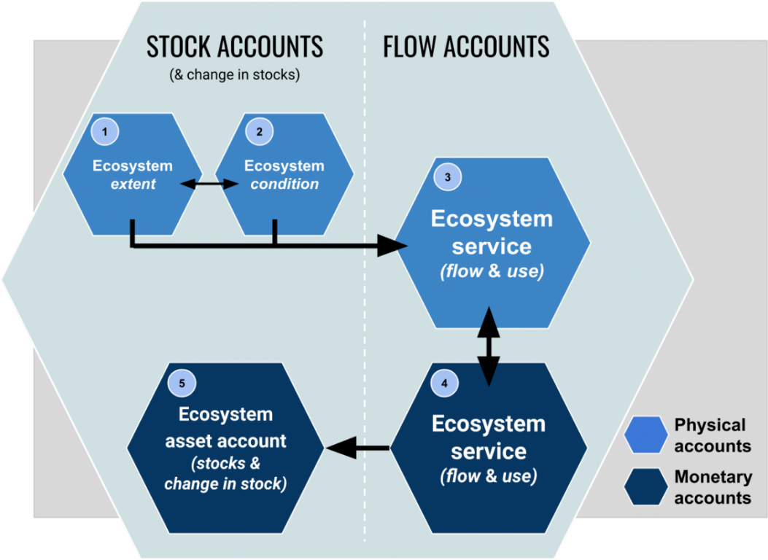

GEP and SEEA Ecosystem Accounting (2021)
Coherent, comprehensive view of ecosystems:
Ecosystem extent
Ecosystem condition
Ecosystem services supply/use
Physical
Monetary
GEP
https://seea.un.org/ecosystem-accounting

Slide 31
Application of GEP to policy and decision-making
Uses of national-level accounting
Examples of applications of GEP in China
Other…

Slide 32
Important challenges and limitations: Philosophical
Putting a price tag on nature/Commodifying nature
Response: value of nature for people AND value of nature for nature
Nature is priceless
Response: yes AND currently nature has an effective price of zero
Ethical questions
What is value in economic sense
Other values that economic sense does not include – intrinsic value, ILK approaches
Distributional issues

Slide 33
Important challenges and limitations: Practical
Globally available and consistent data
Globally consistent methodology – getting agreements on standards
Assembling consistent time series (trends through time)
Non-market valuation
Ground-truthing/validation of ecosystem service models
Accounting for uncertainty
Other…

Slide 34
Important challenges and limitations: Incorporation for decision-making
Accounting is not decision-making (but can be input to decision-making)
Accounting is not benefit-cost analysis
Accounting is not welfare economics
Income vs. wealth
For sustainable development it is more important to have a measure of wealth
Income can be increased at the expense of wealth and long-term income. High rates of extraction, above replacement rate, can generate high current income but at the expense of long-term ability to generate income
In addition to GEP, also important to track changes in natural capital

Slide 35
Concluding thought
The Great Depression in the 1930s led society to realize the urgent need for better macroeconomic performance metrics, such as GDP, to help guide economic policy
The current “Great Degradation” in natural capital should lead society to realize the urgent need for better metrics of ecosystem services and natural capital, such as GEP, to help guide sustainable development

Slide 36
Several remaining questions

Slide 37
Remaining questions
Gross ecosystem product: narrower or broader?
Both GEPs include biotic services (ecosystem services)
Gross environmental product also includes abiotic services and natural resources
GEP and NEP
Accounting for value of changes in the value of natural capital
Exchange value vs. welfare value: SEEA-EA approach or Total Economic Value (TEV) approach
Time period:
2020
Go back to 2000(?) to look at trends

Slide 38
Remaining questions
Inclusion of disservices
Fires
Pests
Vectors of disease
Trade – interregional flows of ecosystem services

Slide 39
Resolution
What does GEP include: ECOSYTEMS
Related to ecosystems in ecology sense (biotic and abiotic components)
Would include water, solar, wind
Not included mineral, oil, natural gas
Disservices
Use flood and flood reduction as model – services as reduction of risk, value the reduction of risk/damages
Fires – currently not doing this. Don’t value the loss from fire. Think about well functioning ecosystem that reduces damages from fires.

Slide 40
Process on producing an initial draft

Slide 41
For each ecosystem service
Clear definition of the ecosystem service
Why it matters to someone
Final or intermediate service – define relationship to other services
Decision on whether to include the ecosystem service
Can be valued globally and included in global GEP
Can be valued in some places (regionally) but not systematically globally (not all regions have reliable data). Example: can value in Europe or US but not in Africa.
Cannot be valued in a reliable/robust way given current understanding.

Slide 42
For each ecosystem service
Methods description
Data for quantity of service
Method for quantity of service
Data for price of service
Method for price of service
Standardized format for reporting definition, decision, and methods

Slide 43
Data and analysis protocols
Justin, Baolong, Ken Bagstad, and others….

Slide 44
Writing sections of the paper
Started writing the paper except results
Introduction
The need for GEP
GEP defined
Brief overview of data and methods to calculate GEP
Discussion
Summary of important findings
Relationship of GEP to SEEA CF and EA (and other efforts)
Applications of GEP to policy and decision-making
Important limitations/challenges
Concluding thoughts
Materials and methods (general)
Supplementary information (detailed)

Slide 45
Challenges: Philosophical
Putting a price tag on nature/Commodifying nature
Response: value of nature for people AND value of nature for nature
Nature is priceless
Response: yes AND currently nature has an effective price of zero

Slide 46
Challenges: Practical
Numerous
Globally available and consistent data
Non-market valuation
Ground-truthing/validation of ecosystem service models
Accounting for uncertainty

Slide 47
Challenges: incorporation for decision-making
Accounting is not decision-making (but can be input to decision-making)
Accounting is not benefit-cost analysis
Accounting is not welfare economics
Income vs. wealth
For sustainable development it is more important to have a measure of wealth
Income can be increased at the expense of wealth and long-term income. High rates of extraction, above replacement rate, can generate high current income but at the expense of long-term ability to generate income
In addition to GEP, also important to track changes in natural capital

Slide 48
Final thoughts
The Great Depression in the 1930s led society to realize the urgent need for better macroeconomic performance metrics, such as GDP, to help guide economic policy
The current “Great Degradation” in natural capital should lead society to realize the urgent need for better metrics of ecosystem services and natural capital, such as GEP, to help guide sustainable development

